Slide 1
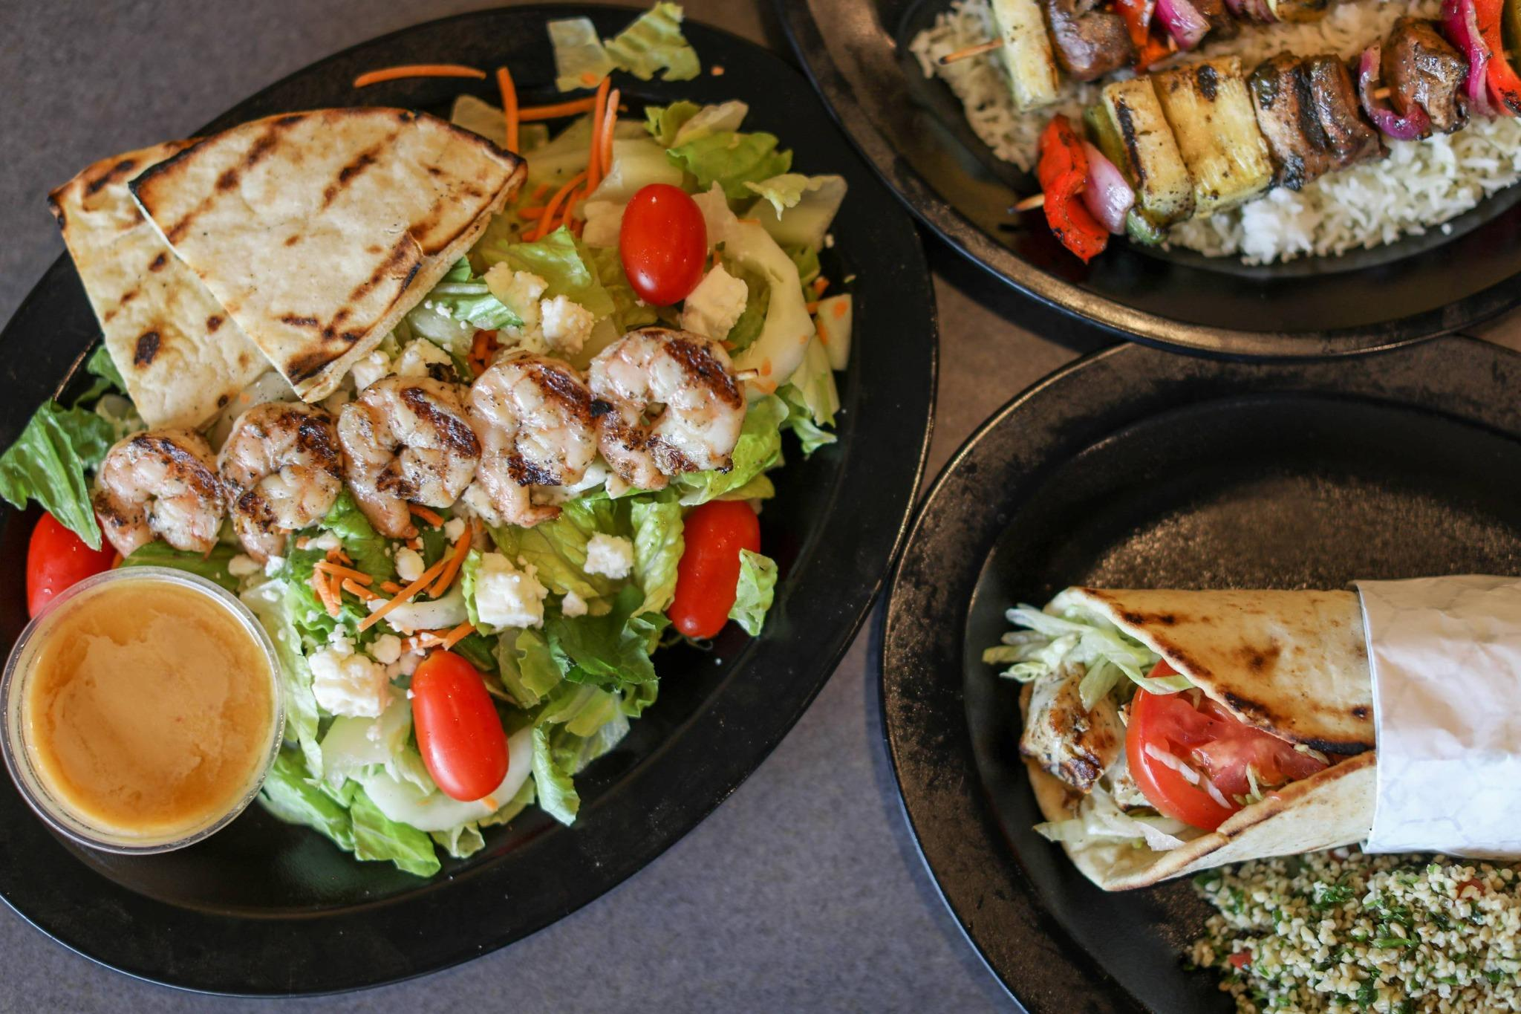
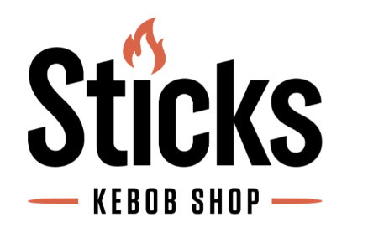
Case Assignment:
Segmentation at Sticks Kebob Shop
Authors:
Hanyu Chen
Parneet Kaur Bhatthal
Iman Faisal
Manvi Sharma
Demi Tran
Ariha Gupta

Slide 2
Background
Established in 2001 and headquartered in Charlottesville, Virginia
Vision to become a trusted haven for food enthusiasts, families on the go, and diners seeking healthier choices
Fell into the fast-growing segment of QSR offering ethnic food
Menu items included:
Sandwiches, Salads, and Platters with homemade sauces
Chicken breast, Chilli-spiked beef sirloin, Shrimp, Lamb, Kibbeh, and Falafel with add-ons
Sides such as hummus, veggies, fries, beans, tabouleh, onion rings, and pita chips
Drinks such as fresh-squeezed limeade and mango lemonade
Company Overview
Key Challenges
Identifying the right markets to enter and
Securing the ideal locations to support its planned expansion of new restaurants
Source: Sticks Kebob Shop case materials from iveypublishing.ca and www.stickskebobshop.com

Slide 3








Customer Value Proposition
Core Value Pillars
Supporting Experience
Healthy & Fresh Mediterranean Food
Fresh ingredients and healthy preparation to health‑conscious customers
Welcoming Ambiance & Friendly Staff
Warm, casual environment with friendly service
Good Value for Money
Affordable pricing for high‑quality, filling meals
Lifestyles
Ideal for active families, soccer players, and young professionals
Fast & Convenient
Quick, reliable service for busy professionals and on‑the‑go diners
Part of Community
Local need to share dining experiences
Great Taste & Satisfaction
Flavor-forward meals delivering on Sticks’ promise of good food
Everyday Reliability
Consistent taste, quality, and speed for your weekly lunch routine
Source: Sticks Kebob Shop case materials from iveypublishing.ca and www.stickskebobshop.com

Slide 4
Segmentation Bases for Cluster Analysis
Base Variables for Analysis: | Why these bases?
Diner Preferences (0% missing values - ‘don’t know’ also treated as missing) | To map customer personas that are closely aligned with Sticks’ vision
D1.3 – Important to buy local products D1.4 – Carefully considers the health benefits of what they eat | Sticks’ local, non-ethnic positioning and focus on quick healthy lunches made it key to understand diners’ preferences for local products and health-focused meals
Core Lunch Behaviour (12-14% missing values cleaned) | To identify attributes of segment most likely to choose Sticks for lunch
D2.1 – Times made/ate lunch at home last week D2.2 – Times brought own lunch to work last week D2.3 – Times bought lunch at workplace (cafeteria) D2.4 – Times bought lunch at a restaurant last week D2.5 – Times skipped lunch last week | Sticks initially targeted working professionals in their mid-20s to mid-40s who visited during lunch breaks. Since it became part of customers’ regular lunch rotation alongside chains like Panera and Chipotle, it was important to examine the attributes most closely linked to diners’ core lunch behavior
Restaurant Selection Criteria (12-14% missing values cleaned) | To understand factors that make customers prefer Sticks to rivals
D4.1 – Importance of convenience D4.2 – Importance of variety D4.3 – Importance of value for money D4.4 – Importance of healthy options D4.5 – Importance of taste & satisfaction D4.6 – Importance of friendly staff D4.7 – Importance of ambiance D4.8 – Importance of consistency/reliability D4.9 – Importance of “part of the community” | Each of the nine base variables captures a distinct attribute customers value when choosing where to dine. By analyzing factors such as healthy options, variety, taste, and value for money, Sticks can design menu items tailored to the right segments. Attributes like ambiance, convenience, consistency, and friendly staff help track customer perceptions and enhance the overall dining experience. All selected variables had minimal missing data, which was removed before conducting the cluster analysis

Slide 5
Descriptors for Target Segment(s) Identification
Descriptors for Analysis: | Why these descriptors?
D5: What is your gender? | Marketing frequency, messaging, and channels differ for attracting female versus male segments
D6: What is your age? | Sticks relies on median age as an important criterion for location decisions
D7: What is your approximate average annual household income? | Household consumer spending is a key factor in Sticks’ location selection
D8: How would you best describe your household type? | Total household spend varies by household type; for example, families with children typically have a higher check average than single diners
D9.1 - D9.3: How many children, by age, currently live in your household? | The number of children determines household size, which in turn influences a segment’s decision and frequency of visiting Sticks
D11.1: If you have children living at home, in what activities do they participate? | The case study notes that Sticks attracts individuals from active families, so activities like soccer may be a useful attribute for targeting this segment
Cust: Customer or not? | Segments that already contain Sticks’ customer personas are more likely to convert and should be prioritized when selecting expansion locations
NOTE: Nearly all descriptors had less than 3% missing values, ensuring effective segment analysis

Slide 6
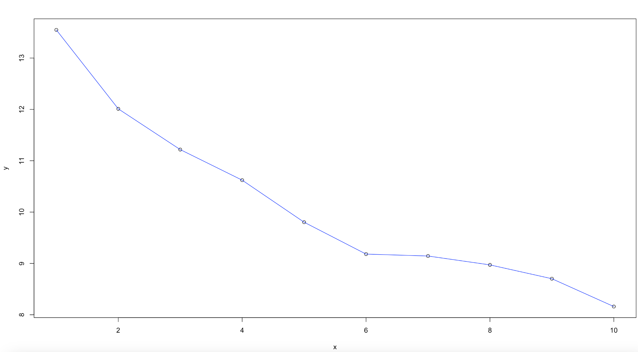
Determining the Number of Segments using Elbow Plot
Cluster Analysis with Base Variables
Identifying the elbow point here allowed us to determine that 6 is the optimal number of segments for cluster analysis.

Slide 7

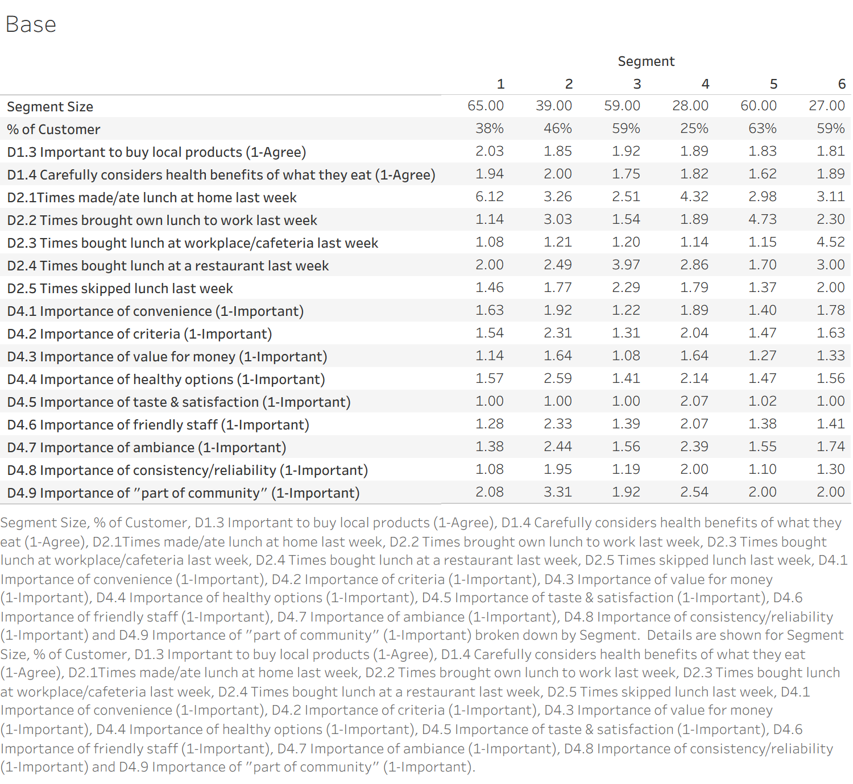
Customer Segmentation Analysis
Segment 3 - Primary Target
Key Insights:
Segment 3 represents the highest potential customer base for Sticks:
Largest attractive segment (59% of surveyed customers)
Highest restaurant meal consumption, with a rating of 3.97 (highest) for lunch bought at restaurant and 2.51 (lowest) for lunch made at home last week
Strongly matches Sticks’ core value:
High importance on Convenience
Value for money
Healthy options
Friendly staff
NOTE: Higher numbers indicate decreased importance for each metric in the figure (i.e., the lower the number, the more important the metric is).

Slide 8
Customer Segmentation Analysis
Segment 5 - Secondary Target
Key Insights:
Segment 5 is a large, value-seeking, health-focused group that can be a strong secondary target for Sticks:
Sizeable dining segment: 63% of surveyed customers
Cost and health conscious: Frequently brings lunch to work, creating an opportunity for Sticks to offer tailored meals that resemble home-made options
Value for money is a key decision factor
Care about great taste and high quality
NOTE: Higher numbers indicate decreased importance for each metric in the figure (i.e., the lower the number, the more important the metric is).

Slide 9
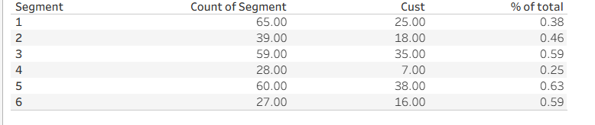
Segments 3 and 5: The Most Aligned and Conversion-Ready Audiences
Customer Segmentation Analysis
Further validating why Segment 3 and Segment 5 prove to be the most attractive
Segments 3 and 5 have a high concentration of existing customers making it a prime target for market penetration
The high percentage of customers also indicates a strong existing alignment with Sticks’ value proposition, suggesting that targeted marketing efforts can drive strong conversion rates

Slide 10
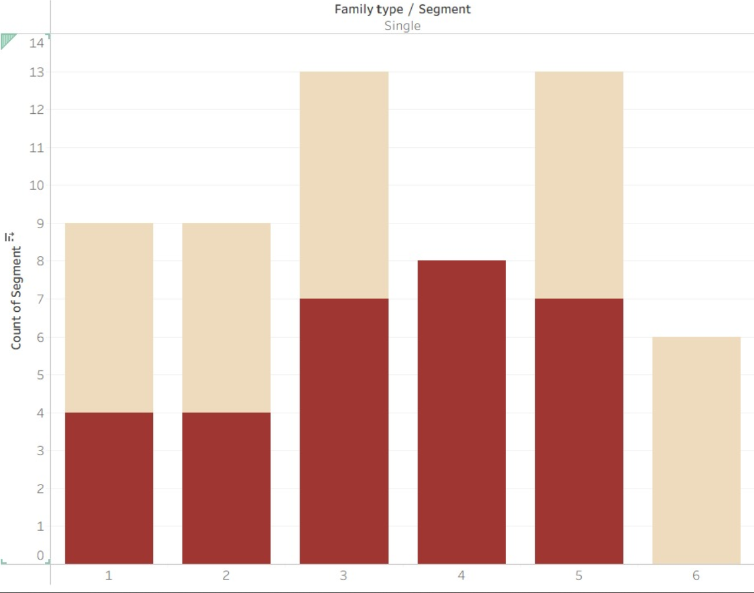

Single people from mid 20’s to mid 40’s
Customer Segmentation Analysis
Key Insights:
As recognized by Dubois and Austin- Sticks historically observed a base skewed towards single people ranging from mid 20’s to mid 40’s
We see here that segments 3 and 5 are leaders with the highest count of single people in the given age buckets, further validating potential to tap into these segments based on existing knowledge and patterns

Slide 11
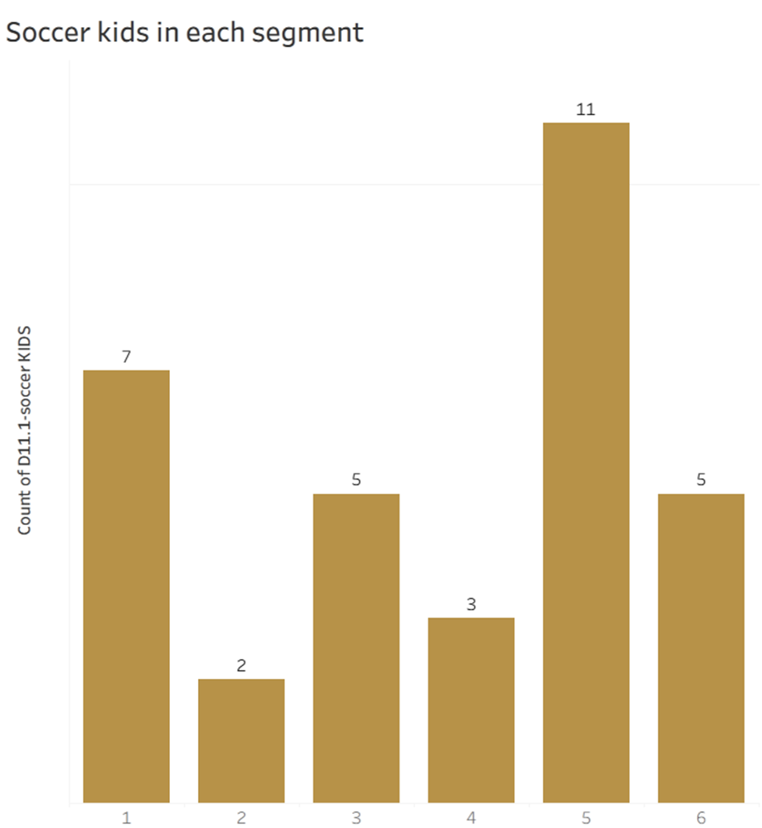

Addressing the Cliche “Soccer Moms”
Customer Segmentation Analysis
Key Insights:
Echoing Dubois’ insight that soccer is central to family life, Segment 5’s high share of soccer kids underscores a natural fit with active, sports-oriented families
Consistent success with these customers signals a possibility of strong brand connection in the future

Slide 12
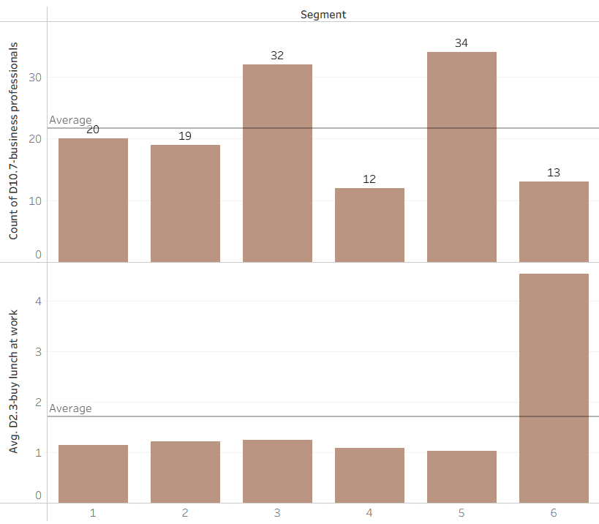
Targeting Business Professionals on Lunch Break
Customer Segmentation Analysis
Key Insights:
Sticks customer base is skewed towards professionals aliging with the target segment:
Segments 3 and 5 have the highest concentration of business professionals, representing a prime target audience for workplace lunch offerings
Despite the above, the average frequency of buying lunch at work is only around once per week, highlighting untapped market potential
Action step:
Position Sticks as the go-to brand for busy professionals seeking healthy lunch options

Slide 13
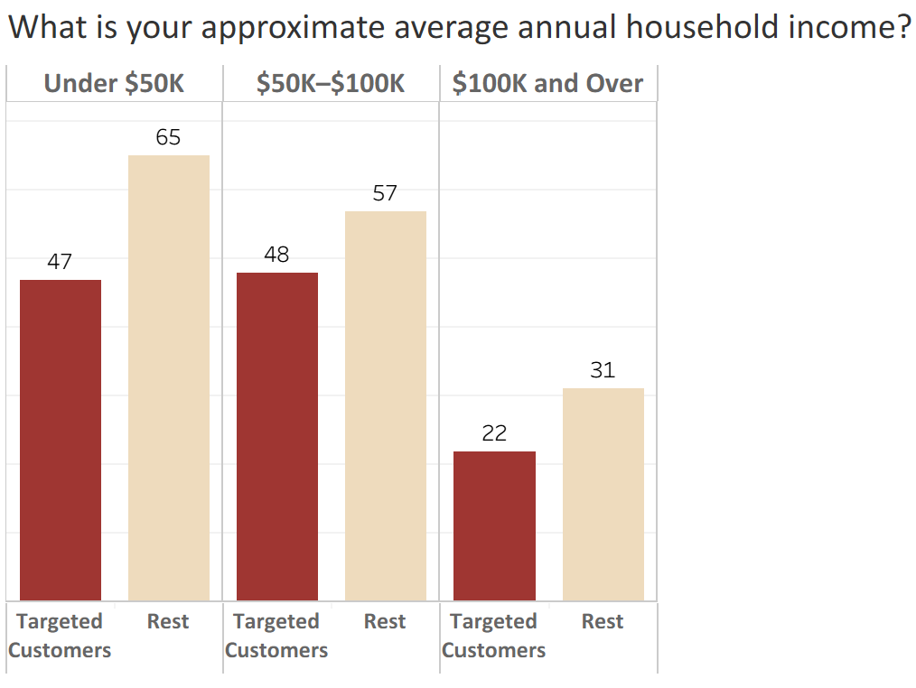
Demographics – Income profile on Target vs. Non-Target
Customer Segmentation Analysis
Key Insights:
Target Customers Skewed Lower-to-Mid Income:
Target customers are primarily concentrated in the under-$50K and $50K–$100K income brackets, indicating a strong preference for value-oriented, budget-conscious households
Higher-income households are under-represented in the target group, with only 22 customers in the $100K+ bracket compared to 31 among non-targets. This indicates that Sticks currently has weaker natural appeal among premium or affluent segments

Slide 14
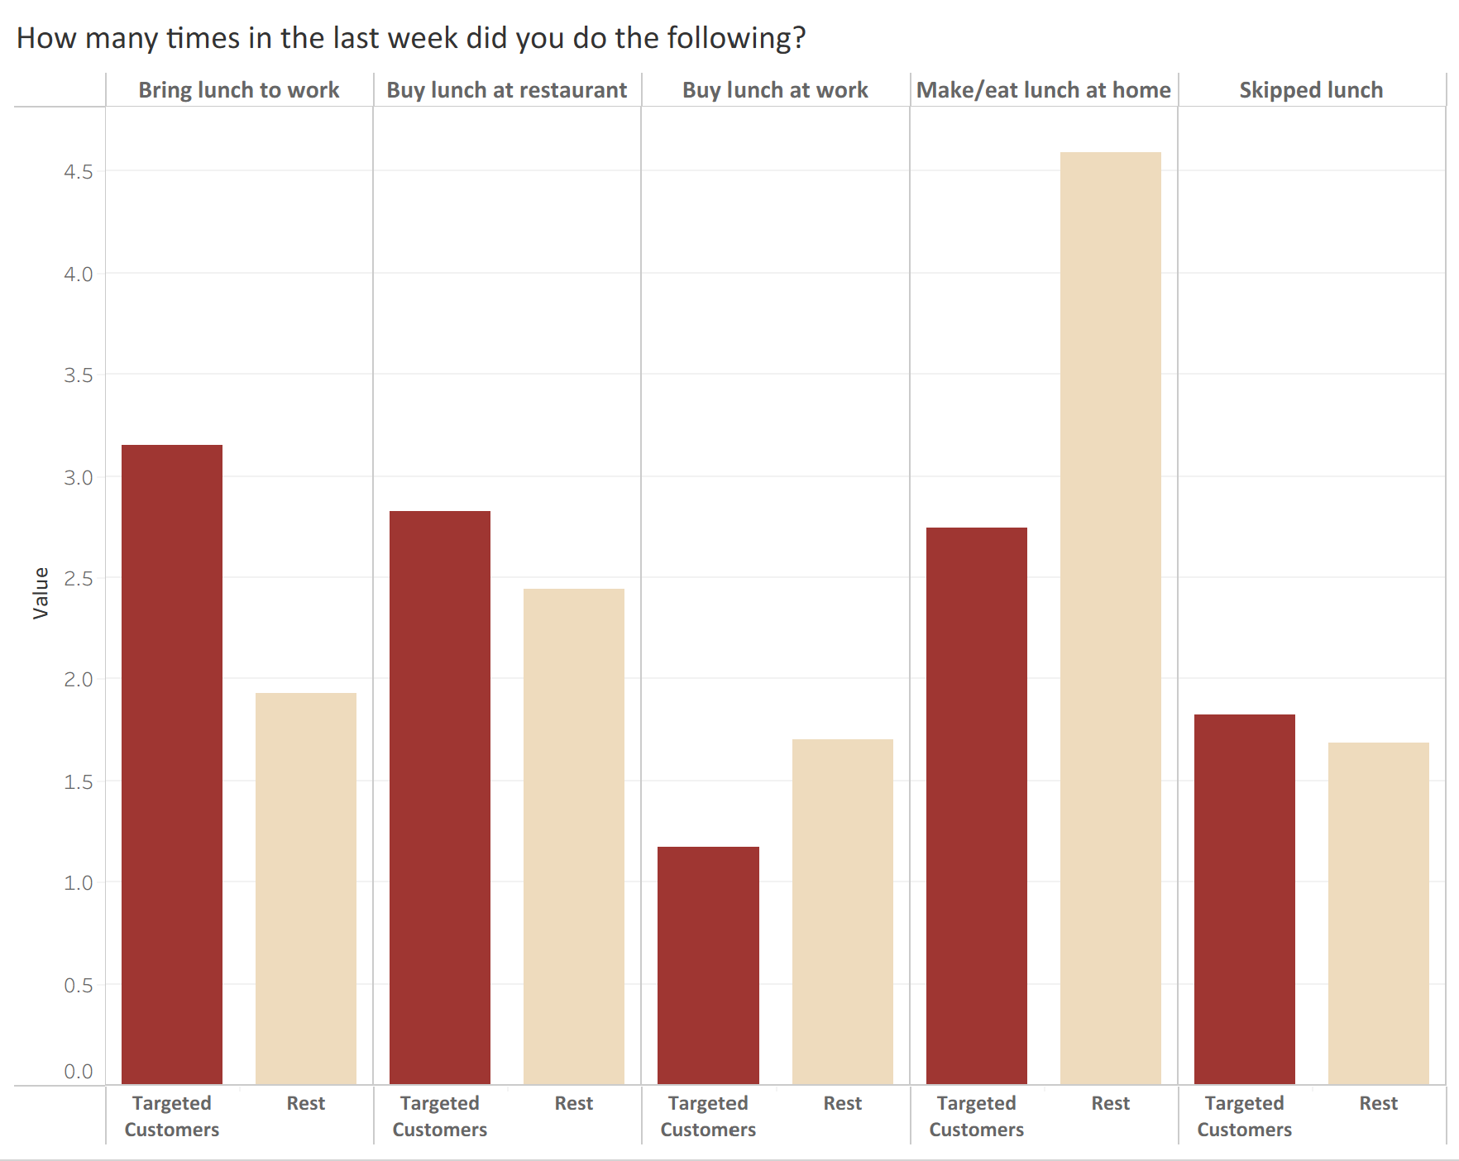

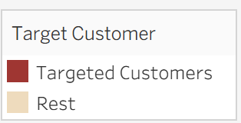
Lunchtime Behavior – Target vs. Non-Target Customers
Customer Segmentation Analysis
Key Insights:
Target customers eat out more, depend less on home or cafeteria meals, and value healthy, convenient options, making them a strong fit for Sticks.
Slightly higher restaurant usage: Buy lunch at a restaurant: 2.8 vs. 2.4x per week
Less tied to eating at home (Target: 2.7 vs. Non-target: 4.6). Targets are less home-locked and more open to outside options.
Heavy “bring-your-own” behavior (Target 3.2 vs. 1.9); targets are health/value-conscious.
Less dependent on workplace cafeterias: Buy lunch at workplace: 1.2 vs. 1.7; targets are more open to off-site restaurants

Slide 15
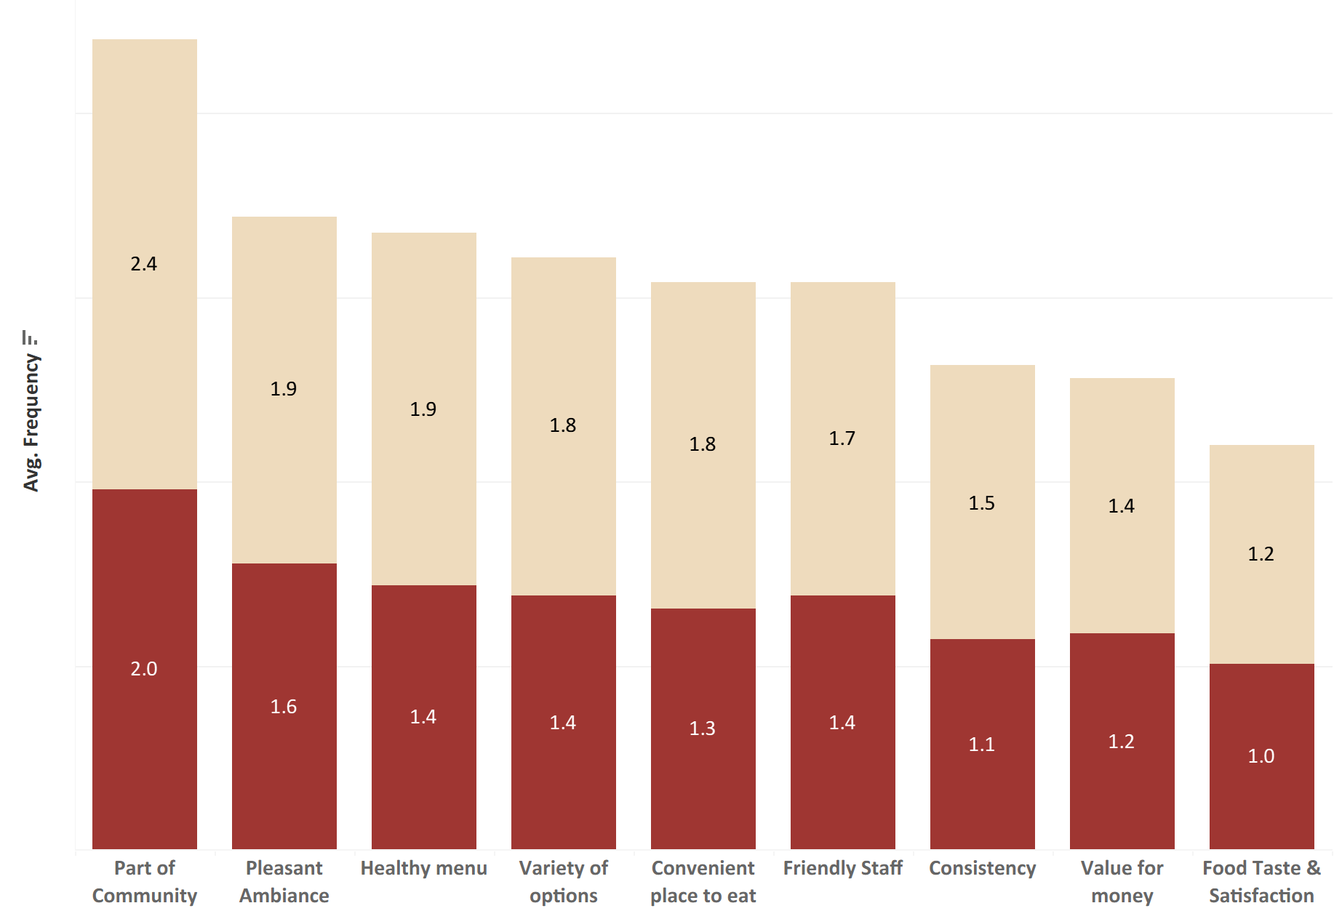
Valuation Metric – Target vs. Non-Target
Customer Segmentation Analysis
Key Insights:
Across every attribute, the target group shows higher expectations and stronger engagement with restaurant choices:
Health, quality, and value remain essential, with targets giving higher scores for healthy menu options, as well as value for money and taste
Community connection stands out as a top priority (2.0 vs. 2.4 for non-targets), identity customers value neighborhood-focused brand
Experience-driven factors matter more, with targets rating pleasant ambiance, friendly staff, and variety of options higher, which are a perfect match for Sticks’ Mediterranean-style service
NOTE: Higher numbers indicate decreased importance for each metric in the figure

Slide 16
Location C: Best Candidate for Sticks Next Store
Restaurant Location Recommendation
Location | Pop. | Median Age | Median Income | Consumer Spend | Consumer Spend Per Household | Major Customer Profiles
A | 29,321 | 39.1 | $92,700 | $722M | $62,404 | Middleburg managers, Movers & Shakers, Upper Crust, Gray Power, Empty Nests
B | 34,183 | 32.5 | $31,900 | $482M | $36,720 | American Classics, American Dreams, Aspiring A-listers, Back Country Folks
C | 42,913 | 32.5 | $55,700 | $754M | $46,828 | Winner’s Circle, Kids & Cul-de-Sacs, Cruisin to Retirement, Beltway Boomers, Executive Suites
D | 57,509 | 34.8 | $75,500 | $1,184M | $57,880 | Striving Selfies, Upward Bound, Generation Web, Young and Influential, Up and Comers
Why Location C?
Best alignment with Segments 3 & 5 (high-repeat, profitable customers)
Median age of early 30s and median income in mid-$50k range aligns with Sticks price and value positioning highlighted earlier
Major customer profiles match Sticks’ quality-focused, convenience-seeking audience including a mix of personas for kids and working professionals
Strong population size and a healthy consumer spend per household ensure steady demand

Slide 17



Why Location C Matches Sticks’ Ideal Customer Profile
Restaurant Location Recommendation
Segment Alignment
Strong overlap with Segments 3 (weekday regulars) and 5 (loyal, long-term customers)
These segments visit frequently, value quality, and drive long-term profitability
Demographic Fit
Working-age couples, young families, mid-to-upper-income professionals
Profiles like Winner’s Circle, Kids & Cul-de-Sacs and Executive Suites match Sticks’ core value-seeking, quality-focused audience
Median income in the mid-$50K aligns perfectly with Sticks’ price positioning
Market Potential
Second-highest population, providing a solid customer base
High overall household spending in the neighbourhood
Enough demand density to support strong performance from launch

Slide 18
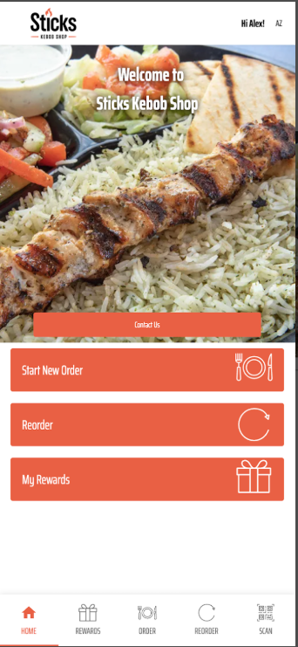
Target Segments & How to Reach Them
Primary Target: Segment 3
Fast, Restaurant-Lunch Diners
Who Are They?
Working women and couples with busy weekdays who frequently visit the restaurant for quick lunch and prioritize convenience, value, health, taste, and staff experience
The Opportunity
Target audience is already buying lunch out daily. Sticks just needs to focus on where they go, for example by treating weekdays as their priority
Core Message
Fast, healthy, flavor-packed lunches for busy professionals who prioritize speed and quality in their dining experience
Loyalty & Partnerships
Offer loyalty punch card for weekday visits
Provide monthly lunch deals at discounted rates
Partnerships with nearby offices and gyms
Advertisements via pamphlets or outdoor boards calling out quick-lunch value proposition
Speed & Convenience
Introduce “Instant Lunch” option on the Sticks’ app
Easy takeout and delivery options
Fast lunch combos ready in under 5 minutes
Clear media signage highlighting brand values
Skip the queue option at a premium price for executives
Execution
Strategy

Slide 19
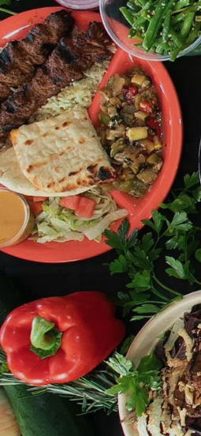
Target Segments & How to Reach Them
Secondary Target: Segment 5
Health & Local Loyalists
Platter
Flatbread Wrap
Who Are They?
Rich couples and families who prefer buying local & healthy food. They mostly make their own lunch at home but are excellent dinner and weekend customers
Core Message
Local food ingredients sourcing, clean eating, and family-friendly meals to make your loved ones happy
Long-Term Value
Aiming to make this segment our loyal customers - customers who bring their kids on weekends, order takeout dinners, and prefer to go for trusted brands
Side Sampler
Pick 6 Family Meal
NUTRITIONAL
INFORMATION
Execution Strategy to build loyal Customer Base
Transparency
Share local sourcing, ingredients and nutritional transparency, e.g. list of local farms, fresh produce, and calories per bowl. Use phrases such as local produce, lean proteins, etc.
Family Appeal
Offer family-style meals such as dinner bowls, meal combos and weekend specials, focusing on healthy and affordable options for both parents and kids
Community Connection
Host occasional pop-ups at festivals, community events, parks or sports centers. Additionally, create seasonal bowls tied to local sourcing of authentic ingredients
Salad
Kids Meal
Soup

Slide 20
Final Takeaways
$
Immediate Revenue
Weekday lunch volume from busy professionals creates steady cash flow and builds operational rhythm
Long-Term Growth
Health-conscious families and local loyalists drive weekend traffic, dinner orders, and word-of-mouth marketing.
Sustainable Success
Together, these segments create a balanced business model with strong revenue and community roots.
Location C is a high-confidence choice for both immediate revenue generation and strong long-term growth. The combination of these two customer segments creates a sustainable competitive advantage.

Slide 21
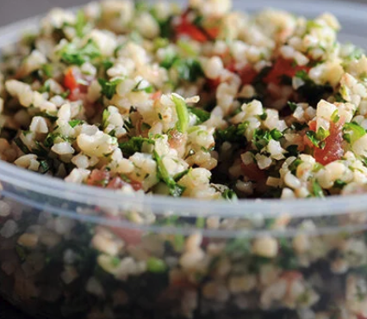



Tools Used
R (Data Cleaning & Clustering analysis)
Tableau (Visualizations)
ChatGPT (Grammar Review)

Slide 22

Thank you.

